Slide 1

The Alphabet Match: an alphabet learning game
Created by Elaine Wang and Jessica Feng
Java Programming CS-170-01
Java Project: Alphabet Game

Slide 2
What is Alphabet Match?
An educational game designed for younger children who are just learning how to say their ABCs
Has interactive material that teaches children the alphabet, with colorful images and buttons
Along with the game itself comes access to the top five player scores and a “How to Play” instructional guide.

Slide 3
EWFrame
A class created to hold the other components of the GUI window
It extends JFrame and creates a window with different sections to put different information in it
Sets the height and width of the window, as well as designs and assigns different panels to different places
Various panels such as the Welcome Panel that warmly invites children to play the game, and Menu Panel that gives the player options on accessing the top scores and directions of the game
PickQuestion method is the most crucial because it contains the game information and picks the questions that the kids answer.
A counter is incremented as kids answer the questions. Then, using case/switch, an integer from the counter is used to build the next question.

Slide 4
EWDriverApp
Includes the main method and executes the code from other classes.
To make sure our code runs smoothly and correctly, we use this to test our program and check for any errors
Sets the frame to visible so that the user can actually see the window and play the game
Creates a new object of JFrame that will be used to hold the game
Simulates the PickQuestion class that will be explained in the next section.

Slide 5
PickQuestion Method
Extends EWFrame and creates a variable to run through the switch statement in EWFrame
Has one constructor that adds the questions into the question pane while building them
The variable ‘count’ differs each time the different codes are built.
Uses many libraries and must import many because they are used often and for various purposes

Slide 6
Question classes
Question classes include all the questions that we display for the children, such as QuestionCat and QuestionOwl.
Similar syntax and format, but they are different questions
There are 2 that do not include pictures, and 8 that have pictures to simulate the visual part of children’s brains, allowing for matching
All extend JPanel and have the method build() in it to build the code and run it.
Use ActionListener that acts when a specific choice is chosen.

Slide 7
Player
Player is a class that can be instantiated into Objects. It holds the user’s name and score.
The constructor is Player(String name, int score)
It has a method that overrides toString() to return player information
Later, Objects that are instantiated from Player can are stored in an ArrayList named playerList

Slide 8
PlayerArrayList
Contains an ArrayList named playerList that holds the Player Objects
Each time a user name and score are added, this information is put into the Player Object, which is then added to the ArrayList.
scanData method: writes the playerList into a file called “scoresfile.txt”
sortScores method: sorts the ArrayList using a Comparator.
Higher scores are put at the beginning of the list

Slide 9
SubmitScore
After completing the last question, another panel appears asking the user to submit score.
When the “Submit score” button is clicked, an ActionListener called submitScoreListener writes the user name and score into the file “scoresfile.txt”
The information in the file is later added into the ArrayList using Scanner class

Slide 10
How the top 5 scores are displayed
The ArrayList playerList from the class PlayerArrayList already holds all the names and scores of users who have already played the game.
After playerList is sorted using sortScores() from PlayerArrayList, playerList’s top 5 entries are copied into a new ArrayList called sortedList.
The info in sortedList is then displayed in a JOptionPaneWindow when user clicks “High Scores”

Slide 11
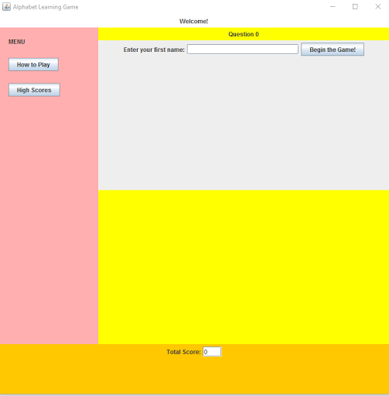
Screenshot of the start of the game
Start of the game where you see the layout of the window and the different panels. It first asks for name to store in the arraylist.

Slide 12
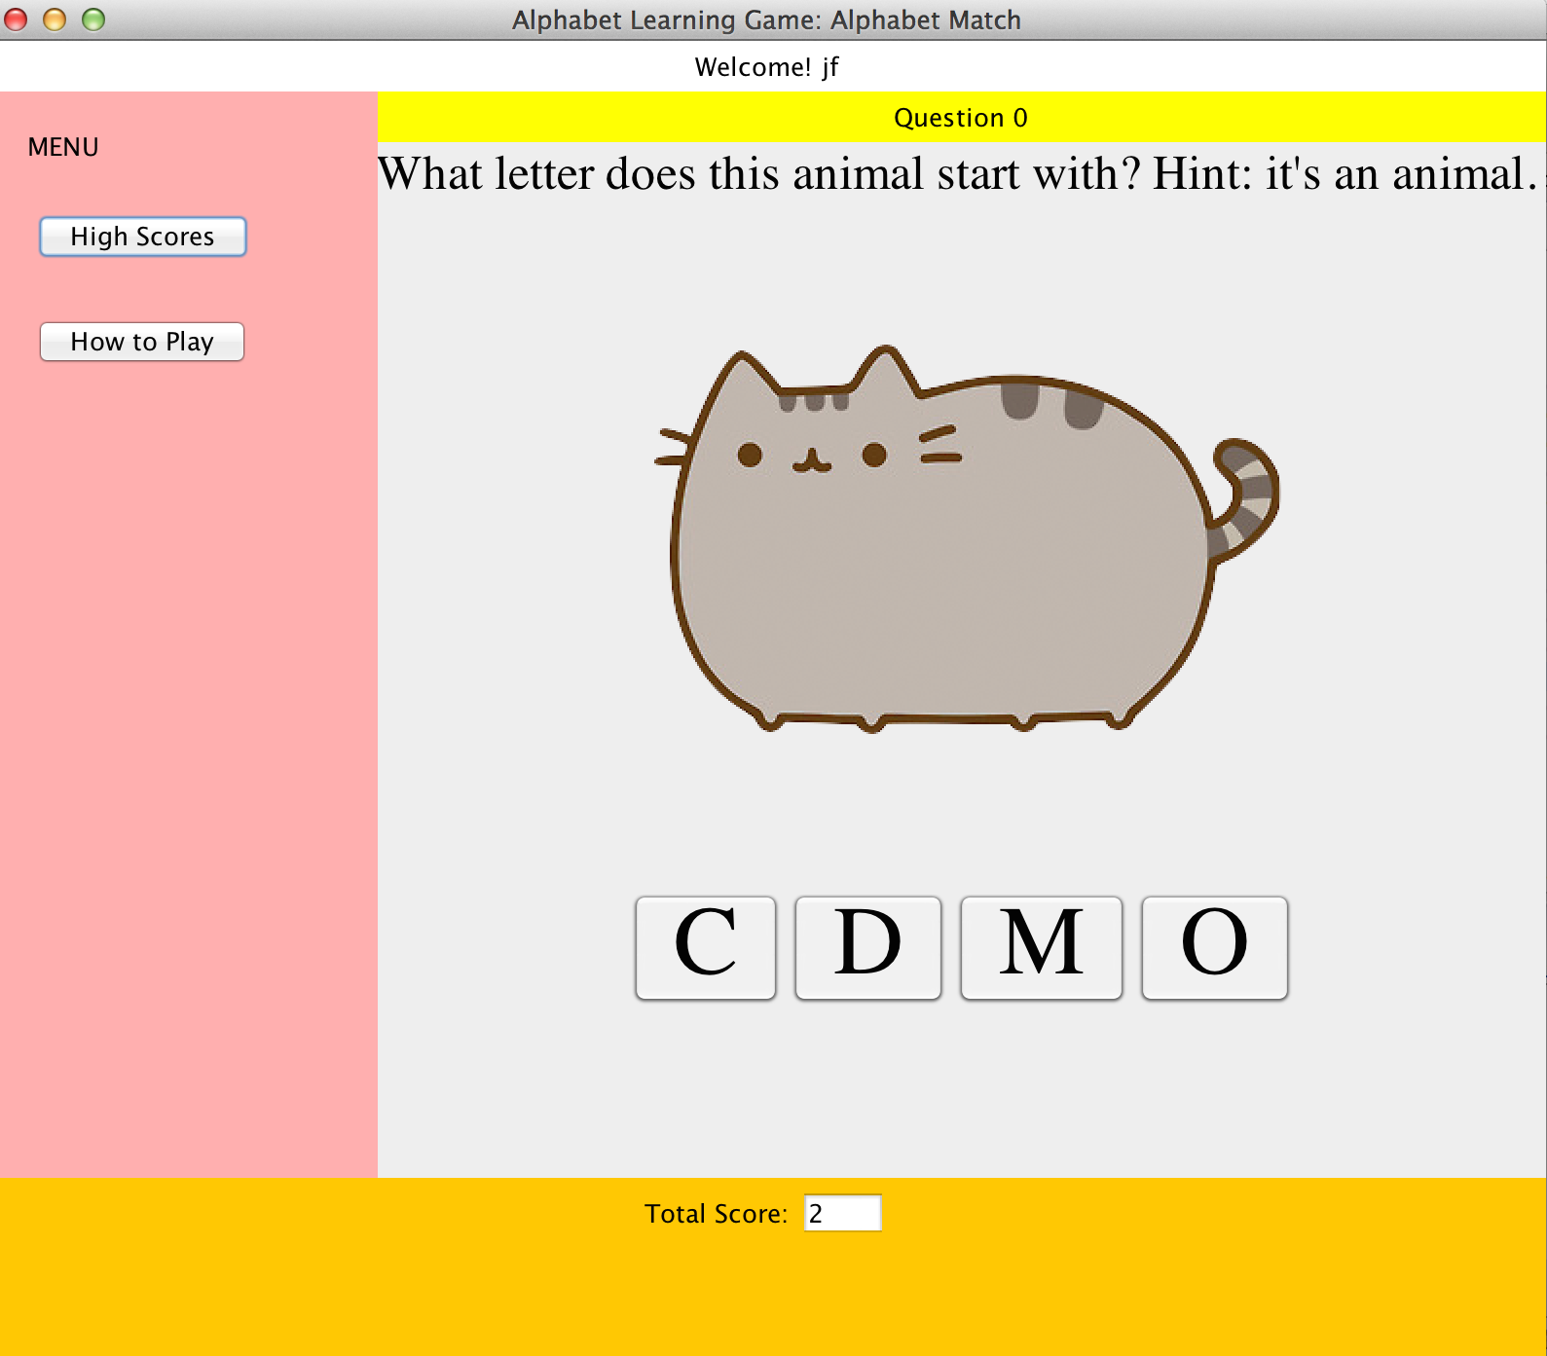
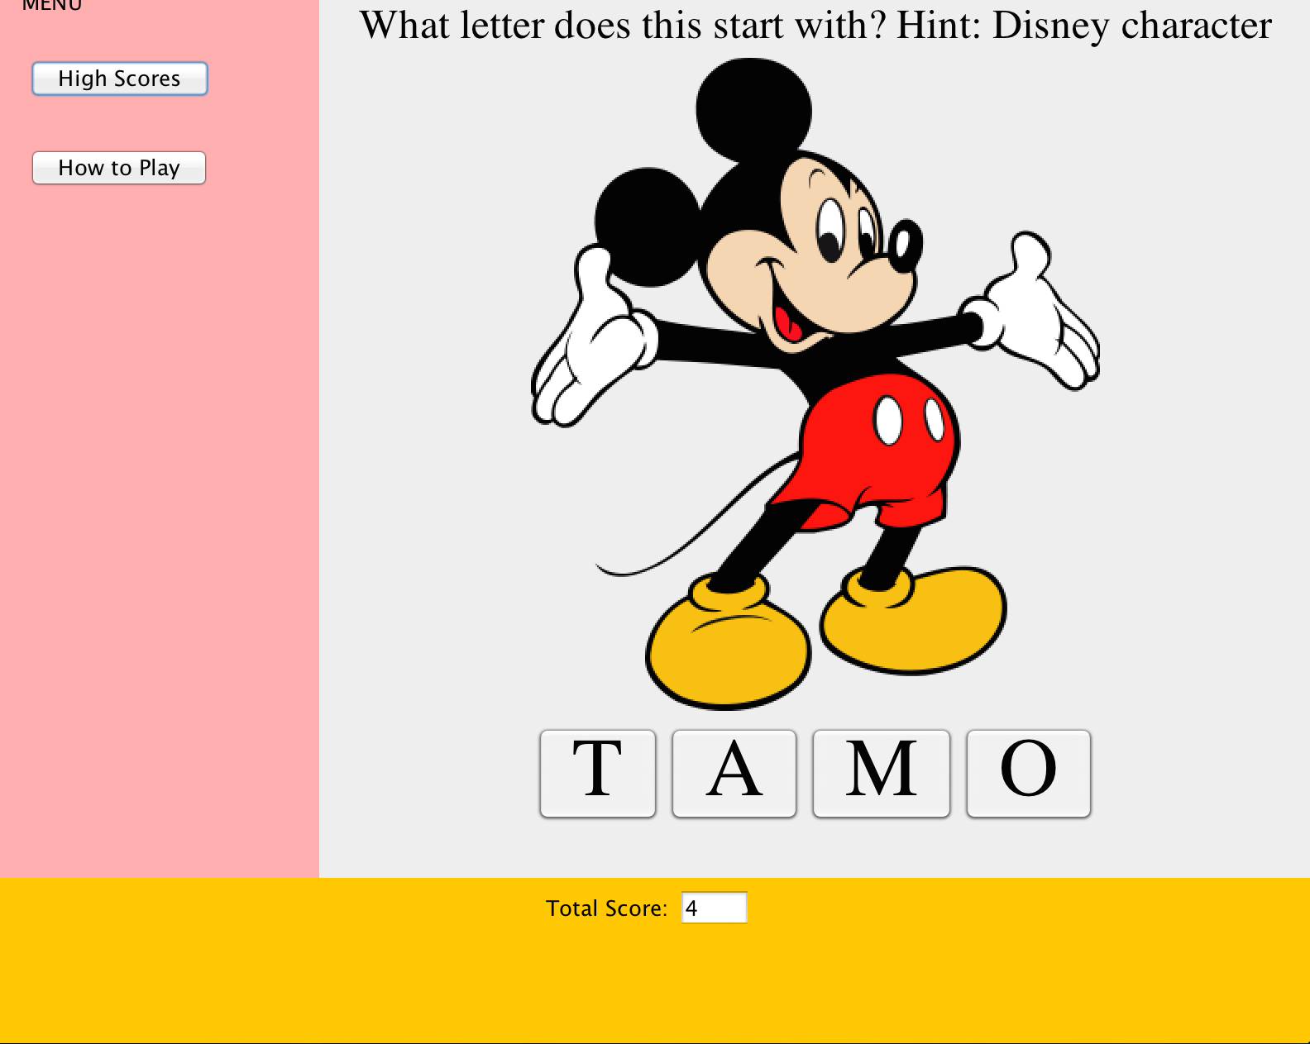
Screenshot: Matching Questions

Slide 13
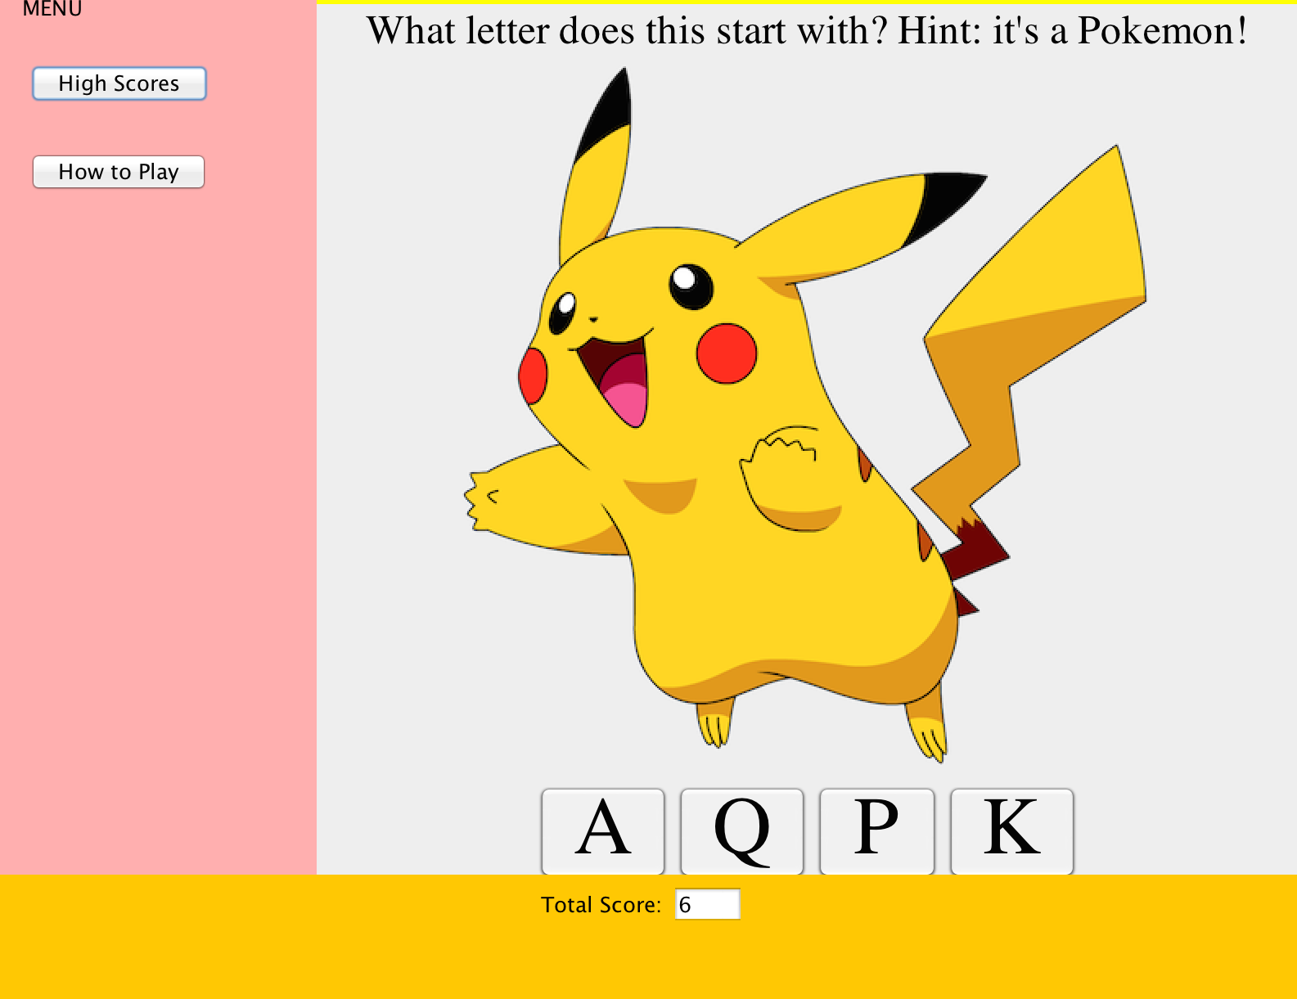
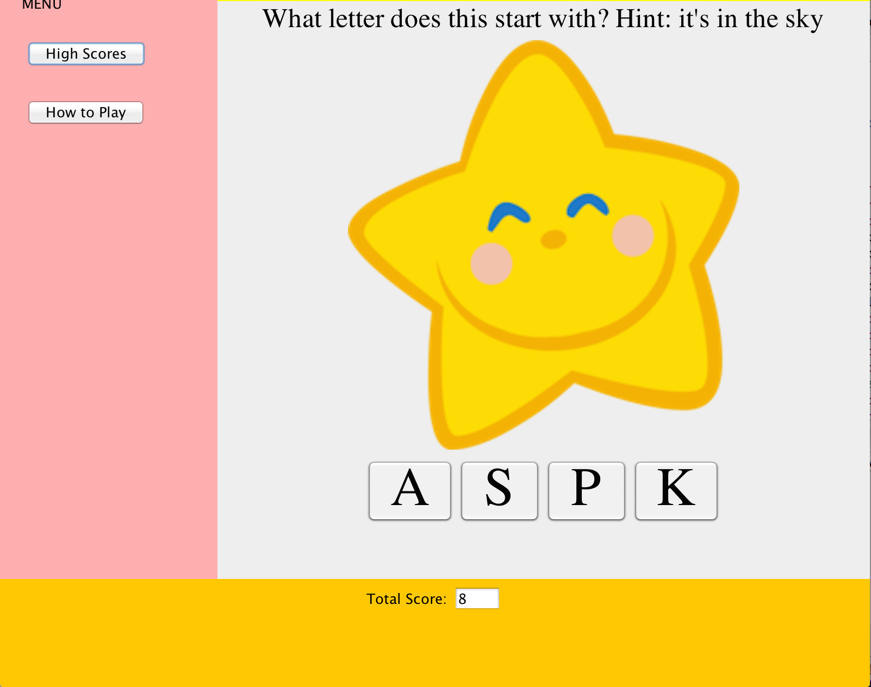
Screenshot: Matching

Slide 14
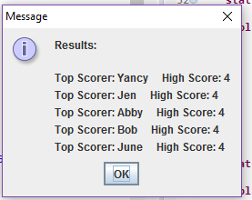
Screenshot: Top Scores

Slide 15
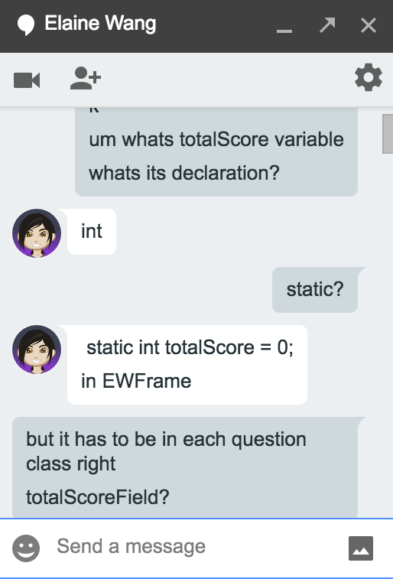
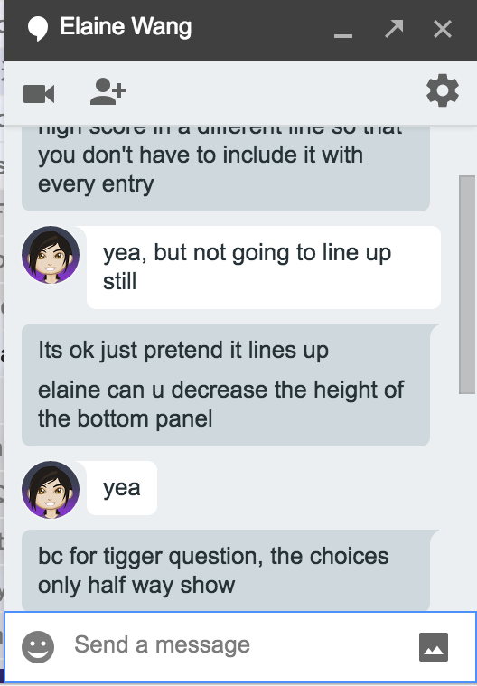
Group Meeting Logs
We met online very frequently because it was more convenient and efficient. We conversed via Google Hangouts and Facebook Messenger. We also used Google Drive to share the project and collaborate on it. We discussed our ideas, the code, errors in the code, how to format our project, etc.

Slide 16
Shared Work
We completed the assignment as a group, as Elaine started the project and Jessica extended off her work. As Jessica’s computer is currently not available because of unknown reasons, we overcame this obstacle, still determined to finish the project despite unfortunate mishaps. She used her phone and other laptops, even though all of her work was lost on her previous laptop, to code the project. Elaine ambitiously coded the fundamentals of the alphabet project, as well as incorporate various useful techniques to use for our project. Jessica coded the buttons and questions mostly, and Elaine designed the game. We had similar ideas in mind, so we collaborated very well and communicated often.

Slide 17
Thank you
Coding this application was very similar to working on a project in the real-world technology community, so we are very grateful that you gave us this opportunity to collaborate and create such an amazing game. Our experience in computer science and programming has increased, as we will continue using all the information you have taught us and bring it with us to the outside world. We sincerely thank you for all the knowledge you have shared with us.

